Slide 1
OPERATING SYSTEMS

Slide 2
Basic Concepts
What is an operating system ?
What is the need for an operating system?

Slide 3
What is an operating System ?
The purpose of an operating system is to organize and control hardware and software so that the device it lives in behaves in a flexible but predictable way.

Slide 4
Computer-System Organization
A computer system supports a lot of I/O devices.
Thus a large portion of operating system code is dedicated to managing I/O.
Each device is controlled by a specific type of device controller.
The device controller is responsible for moving the data between the peripheral devices that it controls and its local buffer storage.
operating systems have a device driver for each device controller.

Slide 5
Single-Processor Systems
On a single-processor system, there is one main CPU capable of executing a general-purpose instruction set, including instructions from user processes.
The variety of single-processor systems range from PDAs through mainframes.

Slide 6
Multiprocessor Systems
These systems have two or more processors in close communication, sharing the computer bus and sometimes the clock, memory, and peripheral devices.
The multiple-processor systems in use today are of two types.
Some systems use asymmetric multiprocessing, in which each processor is assigned a specific task.

Slide 7
Multiprocessor Systems
A master processor controls the system; the other processors either look to the master for instruction or have predefined tasks.
This scheme defines a master-slave relationship.
The master processor schedules and allocates work to the slave processors.

Slide 8
Multiprocessor Systems
The most common systems use symmetric multiprocessing (SMP), in which each processor performs all tasks within the operating system.
SMP means that all processors are peers; no master-slave relationship exists between processors.

Slide 9
Need for an operating system
An operating system adds more functionality to a device.
Operating system achieves this, by running different programs developed for different task.
Operating system allows multitasking.
Without an operating system, every programmer
  have to know the hardware
  Should be able to access the hardware

Slide 10
Need for an operating system
The operating system must ensure correct operation of the computer system.
It should prevent user programs from interfering with the proper operation of the system.
Operating systems must also be concerned with protecting and securing the operating system and users.
Protection are mechanisms that control the access of processes or users to the resources made available by the computer system.
Security measures are responsible for defending a computer system from external or internal attacks.

Slide 11
Processor Modes
Hardware supported rings were among the most revolutionary concepts introduced by the Multics operating system.
To prevent user programs from interfering with the proper operation of the system, these hardware supported rings or modes were introduced.
CPU modes are operating modes for the CPU, that place restrictions on the type and scope of operations that can be performed by certain processes being run by the CPU.
This design allows the operating system to run with more privileges than application software.

Slide 12
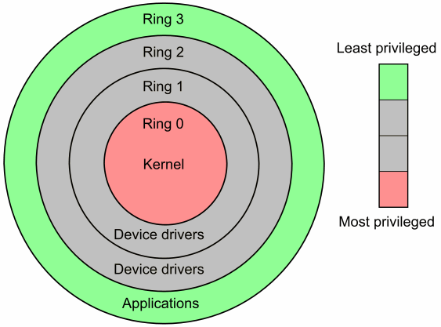
Kernel Mode Vs. User Mode
The Original Multics system had 8 rings.
x86 CPU hardware actually provides four protection rings:
0, 1, 2, and 3. Only rings 0 (Kernel) and 3 (User) are typically used.

Slide 13
Kernel Mode Vs. User Mode
The operating system provides an hardware abstraction layer, and since it must provide resource sharing, every access to the hardware from user programs should be done through the operating system.
To enforce this in a secure way, and prevent malicious or buggy applications to mess up with the hardware, a protection is needed at the hardware level.
Hardware must provide at least two execution levels
They are enforced by the CPU hardware.

Slide 14
Kernel Mode Vs. User Mode
Kernel mode
  In this mode, the software has access to all the instructions and every piece of hardware.
  It can execute any CPU instruction and reference any memory address.
  Kernel mode is generally reserved for the lowest-level, most trusted functions of the operating system.
  Crashes in kernel mode are catastrophic; they will halt the entire PC.

Slide 15
Kernel Mode Vs. User Mode
User mode
  In this mode, the software is restricted and cannot execute some instructions, and is denied access to some hardware (like some area of the main memory, or direct access to the IDE bus).
  Code running in user mode must delegate to system APIs to access hardware or memory.
  Due to the protection afforded by this sort of isolation, crashes in user mode are always recoverable.
  Most of the code running on your computer will execute in user mode.

Slide 16
Kernel Space Vs. User Space
Basically every operating system structures execution into two logical parts, user space and kernel space.
Kernel space is strictly reserved for running the kernel, kernel extensions, and most device drivers.
User space is the memory area where all user mode applications work and this memory can be swapped out when necessary.

Slide 17
Kernel Space Vs. User Space
Kernel space is privileged and can easily return to user space.
However, as user space is unprivileged, it can’t just start running code in kernel space at will.
User space code requires to use system call to start kernel space code.

Slide 18
OPERATING SYSTEM CONCEPTS
An operating system provides the environment within which the programs are executed.
An operating system provides various services.
All operating systems have certain basic concepts such as processes, memory and files.
Understanding these basic concepts helps in understanding an operating system in great deal.

Slide 19
Memory Management
Every computer requires some memory to hold executing programs.
Simple operating systems (Single Task) allow only one program in this memory.
In case if another program is to be executed the first program is removed from the memory and the second program is loaded.
However today’s operating system are capable of executing multiple programs in the memory.
Thus the operating system should provide some mechanism to protect these programs from interfering with each other.

Slide 20
Memory Management
Every process has some address space.
Generally the process address space is less than the main memory in the system.
But today’s 32bit and 64bit systems provide large address space.
A process may use an address space which may be more than the main memory.
In such a case the process will not execute.
To execute such processes today’s operating systems use space on the disk called virtual memory.

Slide 21
Input / Output
All the operating systems or user applications take inputs from users, perform a task and produce outputs.
Thus a computer system should have some physical devices that acquire input from the user and also devices to produce output.
A computer has many input and output devices like keyboard, mouse, monitor, printer etc.
It is the operating system that manages these devices.

Slide 22
File System
All the users and application require to store data.
Operating systems allows the data to be stored in the form of files.
For this the operating system is required to provide an abstract model of the disk independent files.
Operating systems allow a user to organize his data neatly.
Operating system also requires to provide system calls to create files, delete files, write files, read files etc.
Some file systems also provide features that can secure a users data.

Slide 23
User Interface
An interface is required which allows users to communicate with the operating system.
Two fundamental approaches used ----
Command Line Interface or command interpreter.
Graphical User Interface or GUI
Some of the operating systems include command interpreter in the kernel.
However most of the operating systems today treat it as an external program that uses system calls.
The command interpreter is called the shell.

Slide 24
System Calls
Most of the user application tasks are performed by the operating systems like reading file, acquiring input etc.
User applications communicates these tasks to operating systems by using system calls.
Predefined system calls are made available by the operating system.
The system calls execute at the kernel level.
Actual mechanism of issuing a system call is highly machine dependant and often expressed in assembly code.

Slide 25
System Calls
To make it simple a procedure library is provided in C and other languages.
This is also called Application Programming Interface.
If a process running a user program in a user mode requires a system service it requires to execute a TRAP or system call instruction to transfer control to operating system.
If allowed, the system enters a higher privilege mode.
Executes the system call instructions.
Returns back to the calling program’s privilege level.
Returns control to the calling application.

Slide 26

System Calls

Slide 27
System Calls
Three most common API’s available are-----.
WIN32 API
POSIX API
JAVA API
The functions that make up an API typically invokes the actual system calls.

Slide 28
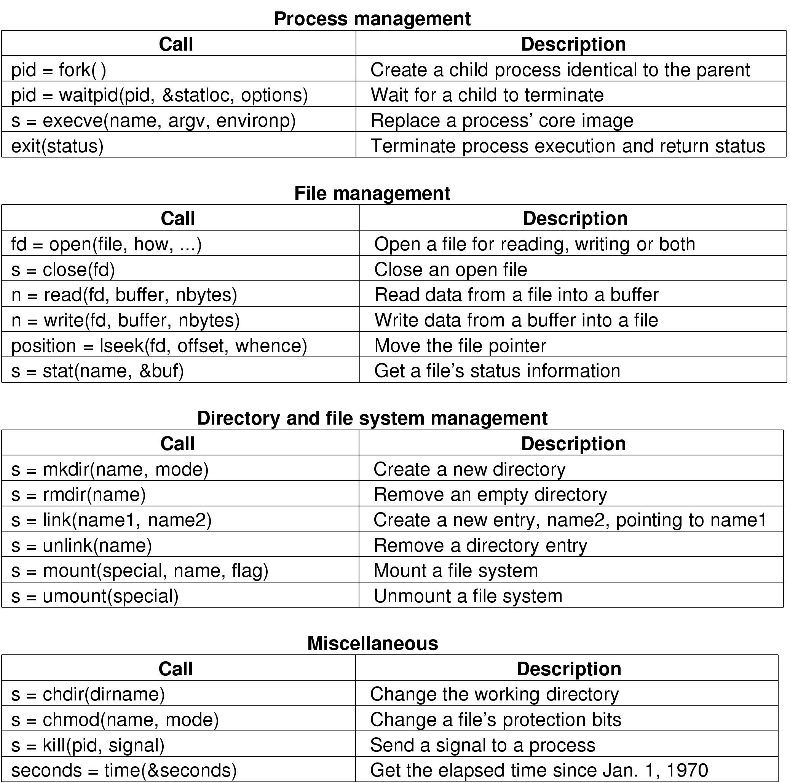
Some System Calls For Process Management

Slide 29
Some System Calls For File Management

Slide 30
OPERATING SYSTEM STRUCTURE
Today’s operating systems are large and very complex.
Thus it must be designed carefully if it has to function properly.
The design considerations must also include future modifications to the operating system.
Many commercial operating system lack a well defined structure.
Five different structures tried in the operating system development.

Slide 31
OPERATING SYSTEM STRUCTURE
Five operating system structures-------
Monolithic Systems
Layered Systems
Virtual Machines
Exokernels
Microkernel (Client-server)

Slide 32
Monolithic Systems
Traditional design of UNIX systems.
Most primitive form of the OS
Practically no structure
Characterized by a collection of procedures that can call any other procedure
All procedures must have a well-defined interface
Does not allow information hiding (private functions for procedures)
Services provided by putting parameters in well-defined places and executing a supervisory call.
Basic structure
  Main program that invokes requested service procedures
  Set of service procedures to carry out system calls
  Set of utility procedures to help the service procedures

Slide 33
Monolithic Systems
User program executes until
  program terminates
  program makes a service request
  a time-out signal occurs
  an external interrupt occurs
Problems with monolithic structure
  Difficult to maintain
  Difficult to take care of concurrency due to multiple users/jobs

Slide 34
Layered System
Hierarchy of layers – one above the other
THE system (1968), MULTICS
Six layers
  1. Allocation of processor, switching between processes
  2. Memory and drum management
  3. Operator-process communication – process and operator console
  4. I/O management
  5. User programs
  6. Operator
MULTICS
∗ organized as a series of concentric rings
∗ inner rings more privileged

Slide 35

Layered Structure
OS divided into number of layers
  bottom layer (layer 0), is the hardware
  highest (layer N) is the user interface
  each uses functions and services of only lower-level layers
Advantages:
  Simplicity of construction
  Ease of debugging
  Extensible
Disadvantages:
  Defining the layers
  Each layer adds overhead

Slide 36
Virtual Machines
Basis for developing the OS
Provides a minimal set of operations
Creates a virtual CPU for every process
IBM System 370 – CMS, VM
  Allowed a number of guest operating systems under the control of VM
  Useful for cross platform development of software

Slide 37
Virtual Machines
  A similar task is accomplished by VMware in recent times
  Provides support for Linux, FreeBSD, DOS 6.0, and Windows 95/98/NT/2000 on the same machine
  Allows the different systems to run concurrently
Physical raw disk or virtual disk
Physical raw disk allows you to use data directly for the native OS, if installed
Virtual disk gives you up to 2GB ﬁle system in a single ﬁle

Slide 38
Virtual Machines
Virtual Machine Monitor
  Virtual CPU.
    Virtualizes CPU for all processes
  Virtual memory.
    Virtualizes memory for all processes
    Single virtual memory shared by all processes
    Separate virtual memory for each process
Virtual I/O devices.
  Performs functions associated with CPU management and allocation
  Provides synchronization and/or communication primitives for process communication

Slide 39

Virtual Machines

Slide 40
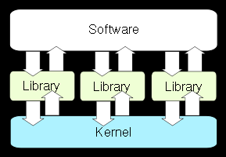
EXOKERNEL SYSTEMS
Exokernel is an operating system kernel developed by the MIT Parallel and Distributed Operating Systems group.

Slide 41
EXOKERNEL SYSTEMS
The idea behind exokernels is to force as few abstractions as possible on developers, enabling them to make as many decisions as possible about hardware abstractions.
Exokernels are tiny, since functionality is limited to ensuring protection and multiplexing of resources, which are vastly simpler than conventional microkernel‘s implementation of message passing and monolithic kernels' implementation of abstractions.

Slide 42
EXOKERNEL SYSTEMS
Implemented Applications are called library operating systems; they may request specific memory addresses, disk blocks, etc.
The kernel only ensures that the requested resource is free, and the application is allowed to access it.
This low-level hardware access allows the programmer to implement custom abstractions, and omit unnecessary ones, most commonly to improve a program's performance..

Slide 43
Microkernel (Client-Server)
Remove as much as possible from the OS leaving a minimal kernel
User process (client) sends a request to server process
Kernel handles communications between client and server
Split OS into parts – ﬁle service, process service, terminal service, memory service
Servers run in user mode – small and manageable
Supports distributed systems

Slide 44
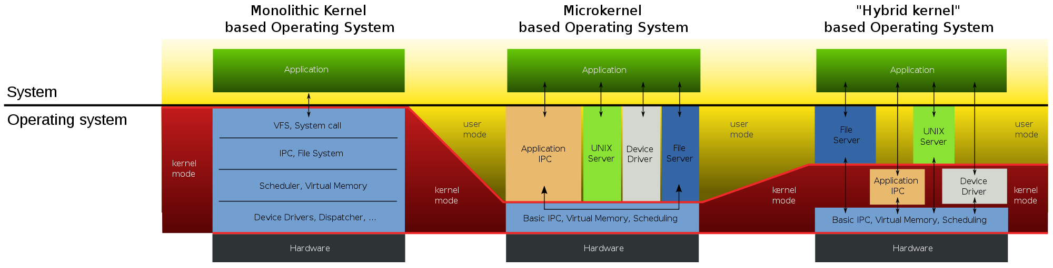
Comparison

Slide 45
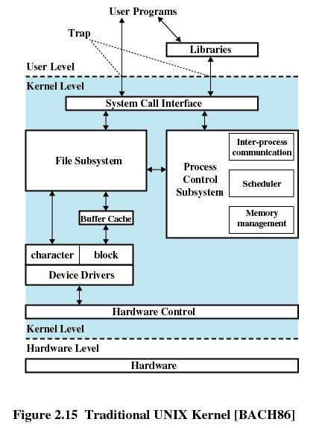

Slide 46
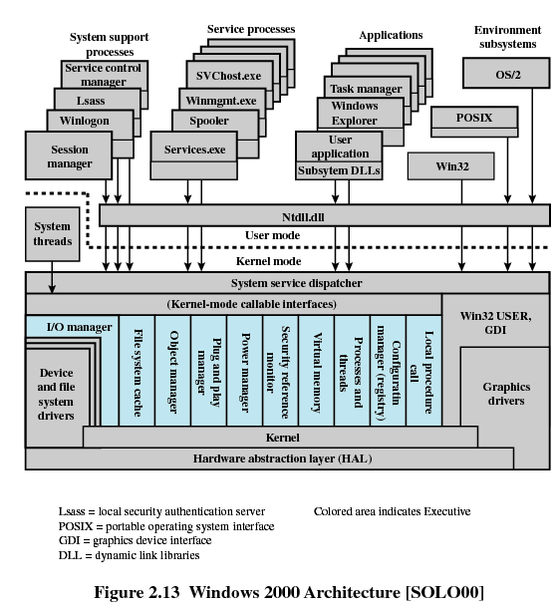

Slide 47
Interrupt Management
Operating System uses a lot of different pieces of hardware to perform many different tasks.
The video device drives the monitor, the IDE device drives the disks and so on.
OS could drive these devices synchronously, that is you could send a request for some operation (say writing a block of memory out to disk) and then wait for the operation to complete. That method, although it would work, is very inefficient and the operating system would spend a lot of time ``busy doing nothing'' as it waited for each operation to complete.

Slide 48
Interrupt Management
A better, more efficient, way is to make the request and then do other, more useful work and later be interrupted by the device when it has finished the request.
With this scheme, there may be many outstanding requests to the devices in the system all happening at the same time.
There has to be some hardware support for the devices to interrupt whatever the CPU is doing.
Some of the physical pins of the CPU are wired such that changing the voltage causes the CPU to stop what it is doing and to start executing special code to handle the interruption; the interrupt handling code.

Slide 49
Interrupt Management
One of these pins might be connected to an interval timer and receive an interrupt every 1000th of a second, others may be connected to the other devices in the system, such as the SCSI controller.
Systems often use an interrupt controller to group the device interrupts together before passing on the signal to a single interrupt pin on the CPU.
This saves interrupt pins on the CPU and also gives flexibility when designing systems.
The interrupt controller has mask and status registers that control the interrupts. Setting the bits in the mask register enables and disables interrupts and the status register returns the currently active interrupts in the system.

Slide 50
Interrupt Management
When a hardware interrupt occurs the CPU stops executing the instructions that it was executing and jumps to a location in memory that either contains the interrupt handling code or an instruction branching to the interrupt handling code.
This code usually operates in a special mode for the CPU, interrupt mode, and, normally, no other interrupts can happen in this mode.
There are exceptions though; some CPUs rank the interrupts in priority and higher level interrupts may happen.

Slide 51
Interrupt Management
Some CPUs have a special set of registers that only exist in interrupt mode, and the interrupt code can use these registers to do most of the context saving it needs to do.
When the interrupt has been handled, the CPU's state is restored and the interrupt is dismissed.
The CPU will then continue to doing whatever it was doing before being interrupted.
It is important that the interrupt processing code is as efficient as possible and that the operating system does not block interrupts too often or for too long.

Slide 52
Examples of interrupts
Mouse moved.
Disk drive at sector/track position(old days).
Keyboard key pressed.
Printer out of paper.
Video card wants memory access.
Modem sending or receiving.
USB scanner has data.

Slide 53
Interrupt Management
A programmable interrupt controller (PIC) is a device that is used to combine several sources of interrupt onto one or more CPU lines, while allowing priority levels to be assigned to its interrupt outputs.
When the device has multiple interrupt outputs to assert, it will assert them in the order of their relative priority.
Common modes of a PIC include hard priorities, rotating priorities, and cascading priorities.
PICs typically have a common set of registers: Interrupt Request Register (IRR), In-Service Register (ISR), Interrupt Mask Register (IMR).

Slide 54
Interrupt Management
The IRR specifies which interrupts are pending acknowledgement.
The ISR register specifies which interrupts have been acknowledged, but are still waiting for an End Of Interrupt (EOI).
The IMR specifies which interrupts are to be ignored and not acknowledged.

Slide 55
Types of interrupts
Synchronous/Asynchronous: Synchronous if it occurs at the same place, every time the program is executed with the same data and memory allocation. Asynchronous interrupts are those that occur unexpectedly.
Internal/External : Internal interrupts arise from illegal or erroneous use of an instruction or data , also called as traps. External interrupts arise from I/O devices, timing device, circuit generated by power supply.
Software/Hardware : Software interrupts is initiated by executing an instruction .

Slide 56
Steps in handling interrupts
Disable further interrupts (Masking).
Store current state of program.
Execute appropriate interrupt handling routine.
Restore state of program.
Enable interrupts.
Resume program execution.

Slide 57
CLOCKS
Clocks or timers are essential to the operation of any multi programmed system.
Clock Hardware –
Two types of clocks are commonly used in computers.
The simpler clocks are tied down to power lines and cause an interrupt on every voltage cycle, at 50 or 60 Hz.
These clocks dominated earlier.
Rare now.

Slide 58
CLOCKS
Clock Hardware –
The other type of the clock is built using three components.
  A Crystal Oscillator
  A counter
  A holding register
When a piece of quartz crystal is properly cut and mounted under tension it generates a periodic signal of high frequency.
Several 100 MHz or more.
By passing this base signal through a multiplier circuit a signal of 1000MHz or more is generated.

Slide 59
CLOCKS
This provides a synchronizing signal to various computer circuits.
This signal is fed into a counter to make it count down to zero.
When counter reaches zero, it causes a CPU interrupt.
Programmable clocks have several modes of operation.
One-Shot mode
The clock starts – holding register value is copied to the counter – counter decrements at each pulse – counter reaches zero – causes interrupt – waits

Slide 60
CLOCKS
Square-wave mode
The clock starts – holding register value is copied to the counter – counter decrements at each pulse – counter reaches zero – causes interrupt – holding register value is copied to the counter – and the process continues…. Continues…
These periodic interrupts are called clock ticks.
The advantage of the programmable clock is that it can controlled by the software.
Programmable clock chips may contain two or three independently programmable clocks.

Slide 61
CLOCKS
To retain the current time even when the computer is turned off, most computers have battery powered back up clock.
Clock Software
The clock hardware generates an interrupt at a fixed interval.
However a clock software or driver is required to perform other tasks like –
Maintain the time of the day
Preventing processes from taking more time than given
Accounting for CPU usage
Handling alarm system calls from user process
Providing watchdog timers for the system

Slide 62
Main OS Process-related Goals
Interleave the execution of existing processes to maximize processor utilization
Provide reasonable response times
Allocate resources to processes
Support inter-process communication (and synchronization) and user creation of processes

Slide 63
OPERATING SYSTEM CONCEPTS
PROCESSES –
A process is a key concept in every operating system.
A process is basically a program in execution.
A process requires some memory to work.
A list of memory locations allotted for a process is known as address space.
A process can read or write that space.
The address space contains the executable program, program’s data and stack.

Slide 64
PROCESSES
Some registers are also associated with each process like program counter, stack pointer etc.
An operating system may stop a running process and may start another process.
However the stopped process is required to be in the same state when restarted.
Thus many operating systems store the information about every process in a table called process table.
The process table does not contain the process’s address space contains.

Slide 65
PROCESSES
Operating systems provide system calls to create and terminate processes.
Generally a running process creates a new process.
When a user executes a program from shell, shell is the running process that will create a new process for that program.
When a process finishes its task, it executes a system call to terminate itself.
The process which initiates another process is called parent process and the initiated process is known as its child.

Slide 66
PROCESSES
Sometimes the multiple processes related to a specific task may require to communicate with each other.
Thus an operating system should provide means for inter process communication.
Operating system is required to provide other system calls related to processes, just than for creating and terminating the processes.
Because a process may require more memory, it may want to wait for its child process to finish.
A process gets the same privileges in the system, as the user who starts it.

Slide 67
Process Creation
When is a new process created?
System initialization (Daemons)
Execution of a process creation system call by a running process
A user request to create a process
Initiation of a batch job

Slide 68
Process Termination
When does a process terminate?
Normal exit (voluntary)
Error exit (voluntary)
Fatal error (involuntary)
Killed by another process (involuntary)

Slide 69
Process States
Running - actually using the CPU
Ready – runnable, temporarily stopped to let another process run
Blocked - unable to run until some external event happens
A process can block itself, but not “run” itself

Slide 70
Process State Transitions
When do these transitions occur?
Running
1. Process blocks for input or waits for an event
2. End of time-slice, or preemption
3. Scheduler switches back to this process
4. Input becomes available, event arrives
1
2
3
Blocked
Ready
4

Slide 71
Five-State Process Model
Dispatch
Release
Admit
New
Ready
Running
Exit
Time-out
Event
Occurs
Event
Wait
Blocked

Slide 72

Scheduling: Single Blocked Queue
Ready Queue
Dispatch
Release
Admit
Processor
Time-out
Event Wait
Event
Occurs
Blocked Queue

Slide 73

Scheduling: Multiple Blocked Queues
Ready Queue
Dispatch
Release
Admit
Processor
Time-out
Event 1
Occurs
Event 1 Wait
Event 1 Queue
Event 2
Occurs
Event 2 Wait
Event 2 Queue

Slide 74
Suspended Processes
Processor is much faster than I/O so many processes could be waiting for I/O
Swap some of these processes to disk to free up more memory
Blocked state becomes blocked-suspended state when swapped to disk, ready becomes
ready-suspended
Two new states
  Blocked-suspended
  Ready-suspended

Slide 75
Process State Transition Diagram with Two Suspend States
New
Admit
Suspend
Admit
Activate
Dispatch
Ready,
suspend
Ready
Running
Exit
Suspend
Time out
Event
Occurs
Event
Wait
Event
Occurs
Activate
Blocked,
suspend
Blocked
Suspend

Slide 76
Process Management Operations
Process creation and termination
Process scheduling and dispatching
Process switching
Process synchronization and support for inter-process communication
The OS maintains process data in the
Process Control Blocks (PCB)

Slide 77
Process Table
Process image consists of program (code/text), data, stack, and attributes
Control Attributes form the Process Control Block - PCB
  Unique ID (may be an index into the PT)
  User ID; User group ID, Parent process ID
  process control information
  Processor state information

Slide 78
Process Control Information
Additional information needed by the operating system to control and coordinate the various active processes
  Execution state:
  Scheduling-related information - state; priority; scheduling info
  inter-process communication - signals; pipes
  Time of next alarm
  memory management - pointers to text/data/stack
  segments
  resource ownership and utilization - open files
  Process relationships: Parent, process group…
  Environment variables

Slide 79
Processor State Information
Contents of processor registers
  General registers
  Program counter
  Program Status Word (PSW)
    condition codes
    mode (user/kernel)
    status register - interrupts disabled/enabled
  Stack pointers - user and kernel stacks

Slide 80
Process Creation
Assign a unique process identifier
Allocate space for the process
Initialize process control block
Set up appropriate linkage to the scheduling queue:
  In the former example: add the PCB to the ready queue

Slide 81
Stop a running process
  Clock event: process has executed a full time-slice
  Process becomes blocked
  Another process is ready
  Error occurred
  Signal received

Slide 82
Process Context Switch
Save processor context, including program counter and other registers
Update the process control block with the new state and any accounting information
Move process control block to appropriate queue - ready, blocked
Select another process for execution
Update the process control block of the process selected
Update memory-management data structures
Restore context of selected process

Slide 83
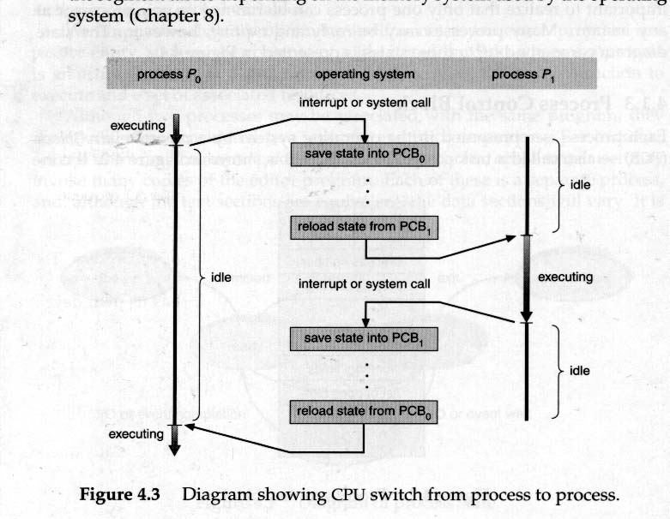
Switching Processes

Slide 84
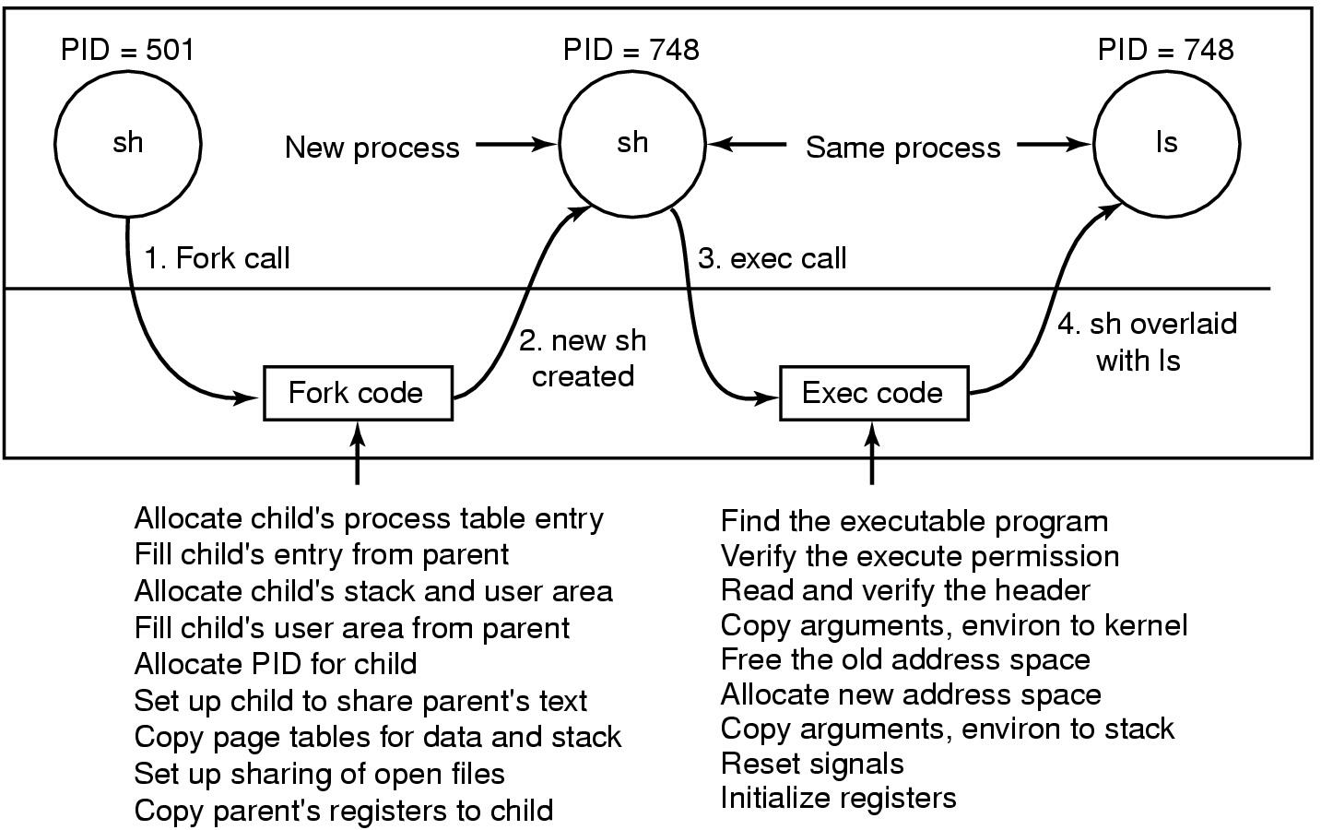
Executing the ls command (interactive Unix)
Steps in executing the command ls, typed to the shell

Slide 85
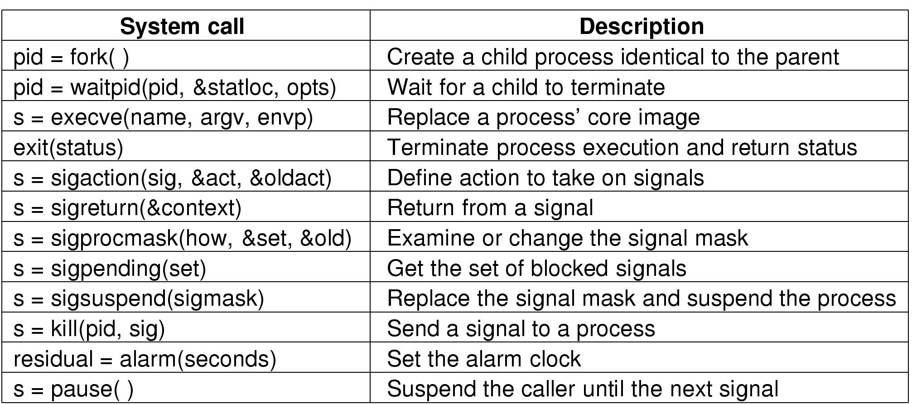
System Calls for Process Management
s is an error code
pid is a process ID
residual is the remaining time from the previous alarm

Slide 86
Terminated processes
If a child process terminates and the parent doesn’t execute `wait’, the child becomes a zombie – it still holds a PTE
An ancestor can receive the process exit code stored in the PTE
Zombie entries can be erased by the kernel when an ancestor executes a wait() system call
What happens if the parent terminates before the child?

Slide 87
Typical Scheduler Goals
Interactive: examples are shells and GUI.
  Spend most of their time waiting for I/O.
  Minimize perceived delay (50-150msec)
Batch:
  compiles long running computations.
  Optimize throughput: can tolerate “large” scheduling latencies but want to maximize the number of jobs completed over some given time interval.
Real-time
  Require predictable behavior.
  May require guarantees on throughput, latency or delay
  .

Slide 88
Scheduling Algorithms
FIFO (or FCFS)
  Easily implemented
  Average waiting time may be long with this policy
  Convoy effect or head-of-line blocking: short process behind long process; many I/O bound processes behind CPU-bound process results in inefficient use of I/O resources
Shortest-Job-First (SJF)
  optimal in that it provides the minimum average waiting time for a given set of processes
  can use exponential averaging to estimate next burst size
  non-preemptive and preemptive versions
Priority-based
  preemptive or non-preemptive
  static or dynamic priorities
  problem: Starvation. Solution: Aging.

Slide 89
Scheduling Algorithms
Round-robin
  time-sharing, define quantum, bounded wait times (n-1)/q
  large q => FCFS, small q => dedicated processor of speed F/n (processor sharing)
Multilevel Queue
  ready queue partitioned into bands or priorities
Multilevel feedback queue
  use feedback to move process between queues

Slide 90
Threads
Need:
  Multiprogramming within a single application
  Using the same environment for performing different tasks concurrently

Slide 91
Single and multithreaded processes
process control block
code
data
files
process control block
code
data
files
registers
user/kernel stacks
registers
registers
registers
Thread control blocks
user
/kernel
stacks
user
/kernel
stacks
user
/kernel
stacks
thread
thread
thread
thread
single threaded
multithreaded

Slide 92
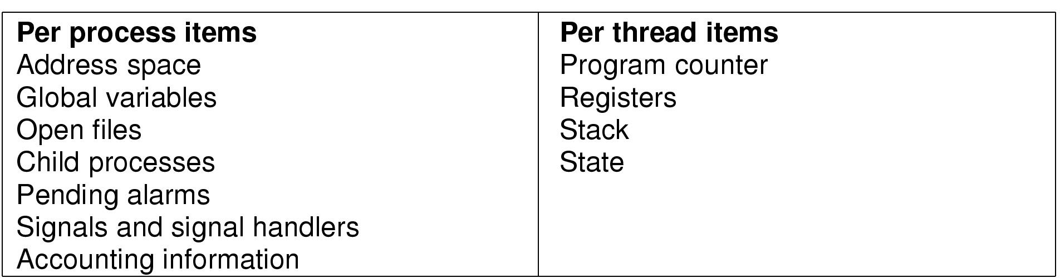
The Thread Model

Slide 93
Processes Threads
The basic unit of CPU scheduling - threads:
  program counter; register set; stack space
Peer threads share resources like code section and data section
a process is created with a single thread
multi-threaded tasks (processes) can have one thread running while another is blocked
Good for applications that require sharing a common buffer by server threads
A word processor can use three threads
  Updating the display (WYSIWYG)
  Interacting with the user (keyboard & mouse)
  Dealing with i/o to the disk

Slide 94
Processes Threads
Multithreading in different operating systems:
  Operating systems support multiple threads of execution within a single process
  Older UNIX systems supported multiple user processes but only one thread per process; new Unix systems have multiple threads.
  Windows NT supports multiple threads

Slide 95
The Benefits of Threads
Takes less time to create a new thread than a process
Less time to terminate a thread than a process
Less time to switch between two threads within the same process
Threads within the same process share memory and files --> they can communicate without invoking the kernel

Slide 96
User-Level Threads
All thread management is done by the application
The kernel is not aware of the existence of threads
Thread switching does not require kernel mode privileges (and is thus faster)
Scheduling is application specific (can thus be more efficient)
System calls by threads block the process

Slide 97
Kernel-level Threads
Kernel maintains context information for the process and the threads
Kernel can schedule different threads of the same process to different processors
Switching between threads requires the kernel
Kernel threads can simplify context switch of system functions

Slide 98
DEADLOCKS
This situation may occur between two or more processes when they are interacting.
The deadlock situation generally happens when processes require same resources to complete their tasks.
However one process gets access to one set of resources and the other process gets access to other set of resources.
E.g. Process 1 and process 2 both require access to tape drive and CD-Writer to create backup. Now P1 requests access to tape drive and gets it. P2 requests access to CD-Writer and gets it. Now when P1 requests access to CD-Writer it is suspended till P2 finishes…….

Slide 99


